Slide 1

Introduction to
Snap 9 professional
MKTG2341 PC Lab Week 4
MKTG2341 PCLab 5

Slide 2
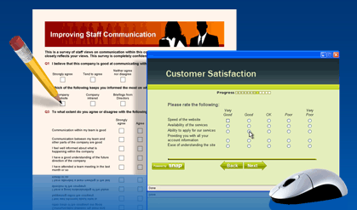
Intro to Snap 9 Professional
Powerful software for the design, publication and analysis of surveys.
Multiple modes: Paper, Email, Web, Scanning, PDA, Tablet PC, Kiosk and CATI.
MKTG2341 PCLab 5

Slide 3

Intro to Snap 9 Professional
Robust analysis capability: Tables, Charts, Reports, Descriptive and Multivariate Statistics.
Database integration with MS Office (Word, Excel, PowerPoint, Access) and SPSS.
MKTG2341 PCLab 5

Slide 4
Intro to Snap 9 Professional
Loaded in SE6 Computer Labs and the downstairs computer room in the Library.
Manuals
  QuickStart Guide
  5 detailed Manuals
Manuals accessible two ways:
The computer click Programs | Snap
Share Out.
MKTG2341 PCLab 5

Slide 5
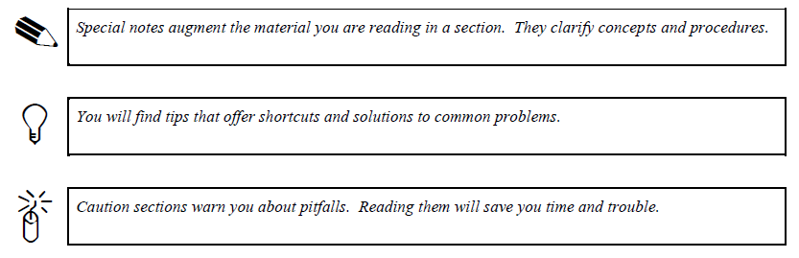
Conventions Used in the Guides
Menu commands are separated with a vertical bar and the commands appear in a bold font.
  Tailor | Data Entry = open the Tailor menu and choose the Data Entry option.
MKTG2341 PCLab 5

Slide 6

Today’s Lab
QuickStart Guide is written as a step-by-step tutorial.
We will work through much of that in the PC Lab today.
We’ll use the sample survey snCrocodile.
  You should save a copy in your personal files for later reference.
MKTG2341 PCLab 5

Slide 7
Today’s Lab
Topics covered:
Designing a Questionnaire
  Keys used in Questionnaire Design
  Question types
Questionnaire Window Modes
  Design Mode
  Style Mode
  Data View Mode
Question Formatting
MKTG2341 PCLab 5

Slide 8
Questionnaire Design
Keys used in Questionnaire Design
Title and a Sub-Title.
Multi Choice Question.
“Other, Please Specify” Question.
Series of Grid Questions.
Open or Comments Question.
Access Questions from the Demographics and Lifestyles SurveyPak.
MKTG2341 PCLab 5

Slide 9
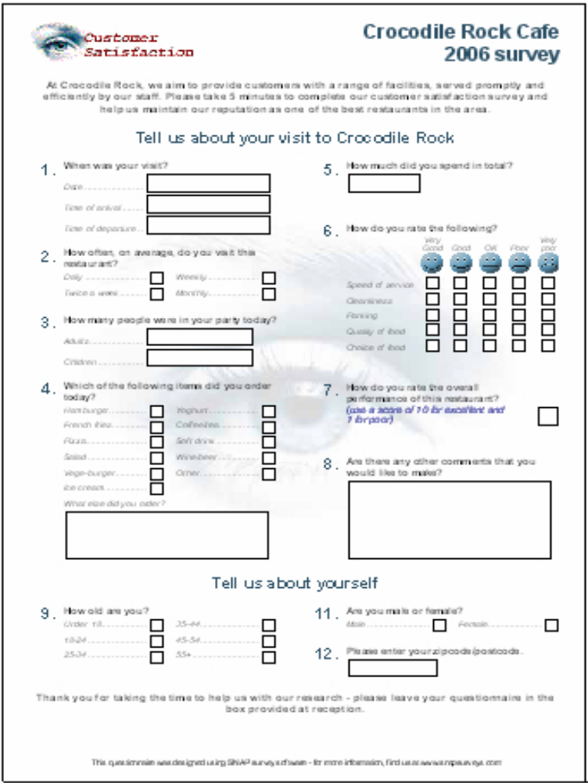
Questionnaire Format
Pre-set Templates
Preview and Print
Internet Surveys
Publishing
MKTG2341 PCLab 5

Slide 10
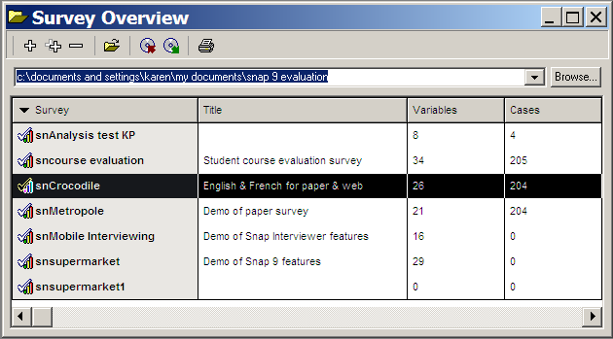
Sample Survey
Variables ~ Questions
Cases ~ Respondents
We will look at a sample survey
Notice the filename:
Snap automatically prefixes the survey with the letters sn.
MKTG2341 PCLab 5

Slide 11
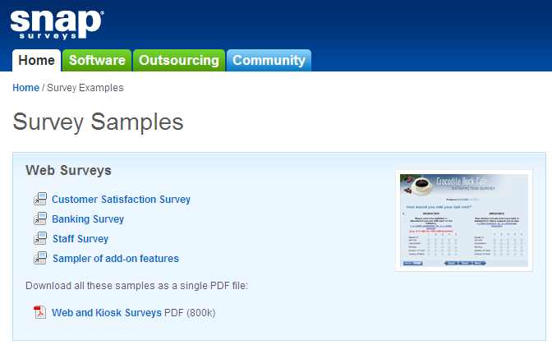
More Sample Surveys
http://www.snapsurveys.com/samplesurveys/#
Extra design & formatting features
MKTG2341 PCLab 5

Slide 12

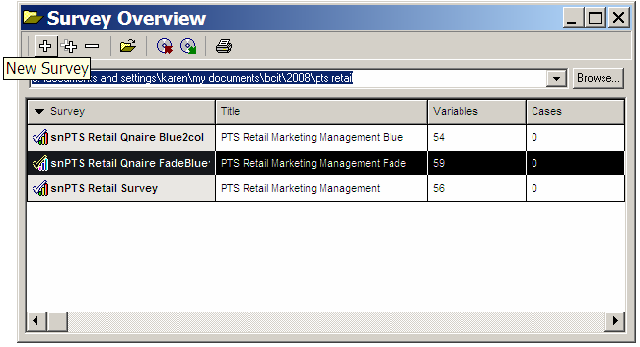
Start a New Survey
QuickGuide pg. 4:
Click Program | Snap
In Survey Overview click on the plus sign
MKTG2341 PCLab 5

Slide 13
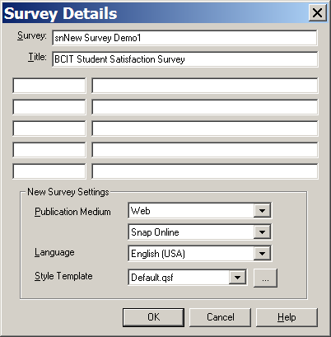
Creating a New Survey
Notice the filename:
Snap automatically prefixes the survey with the letters sn.
MKTG2341 PCLab 5

Slide 14



Questionnaire Window Modes
QuickGuide pg. 5:
Three Modes:
Give you 3 sets of tools.
MKTG2341 PCLab 5

Slide 15
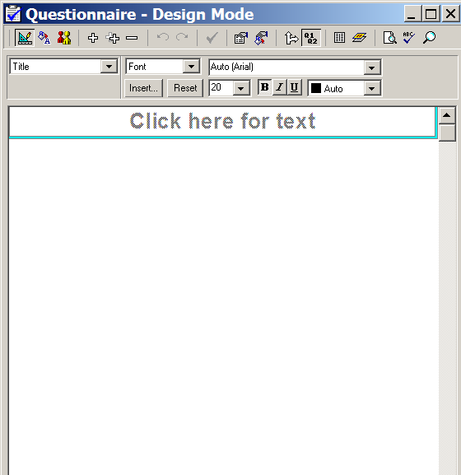
Creating a New Survey
You are in the design mode.
You are now ready to create a new survey.
MKTG2341 PCLab 5

Slide 16
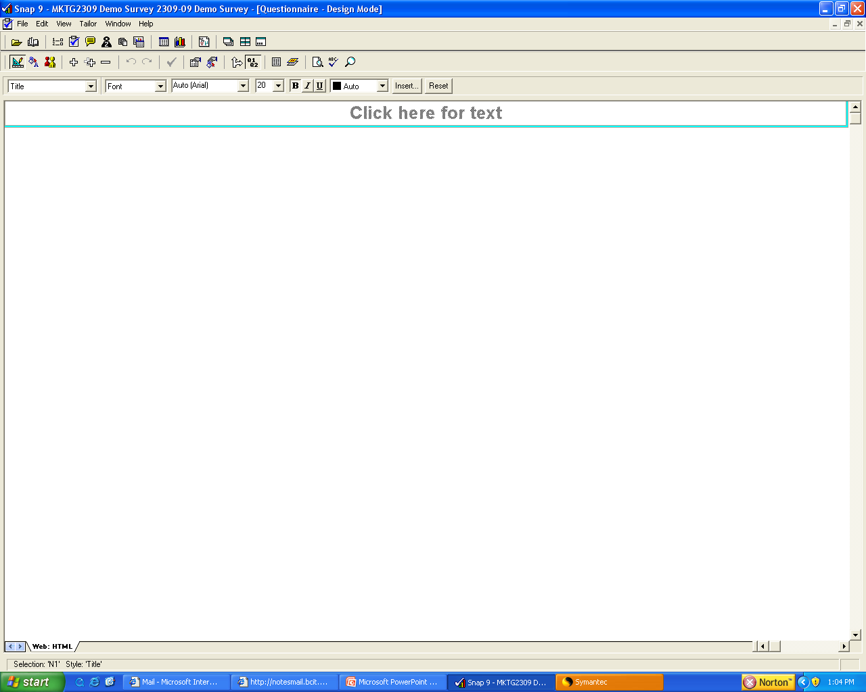
This is the ‘field’ that you are currently working on.
MKTG2341 PCLab 5

Slide 17
This box is where you choose the type of question you want to insert into the field.
MKTG2341 PCLab 5

Slide 18
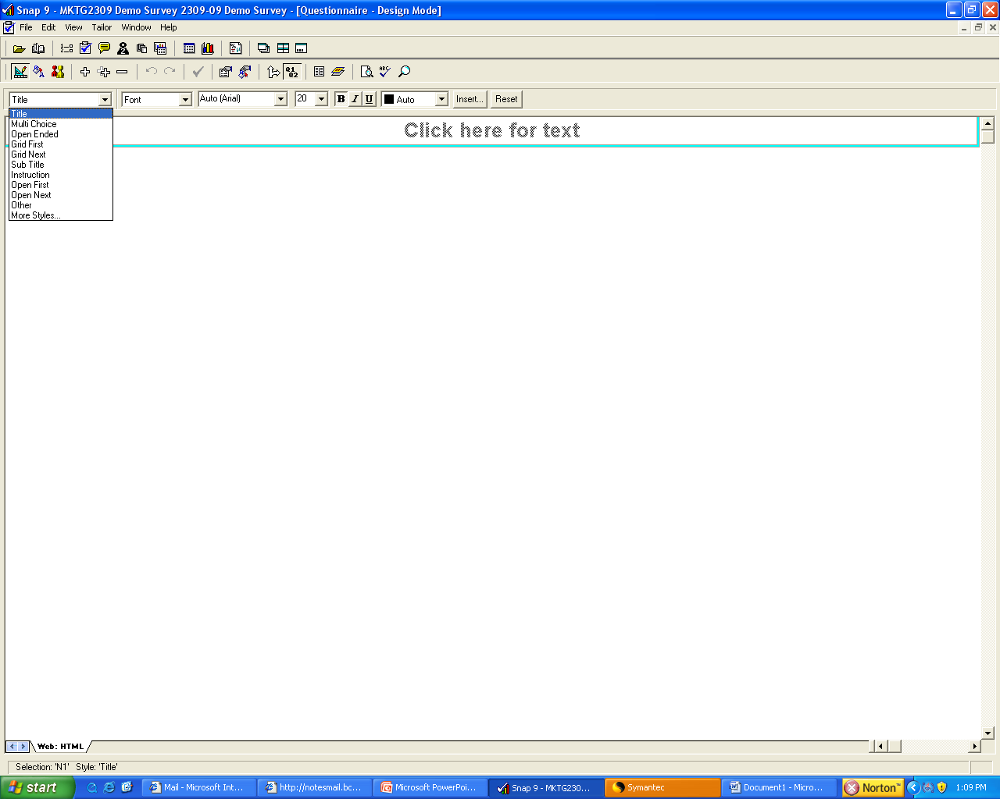
These are your field options. You can create a variety of different question types, titles, and instructions.
MKTG2341 PCLab 5

Slide 19
This drop-down box offers you a variety of formatting options.
MKTG2341 PCLab 5

Slide 20
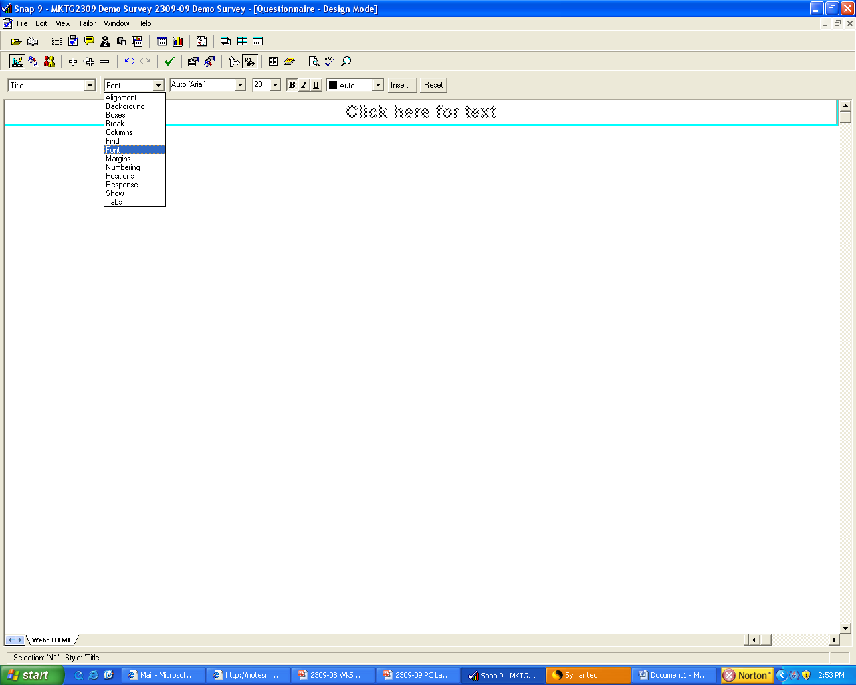
Clicking on any one of the formatting options will affect the functions that you see in the task bar to the right .
MKTG2341 PCLab 5

Slide 21
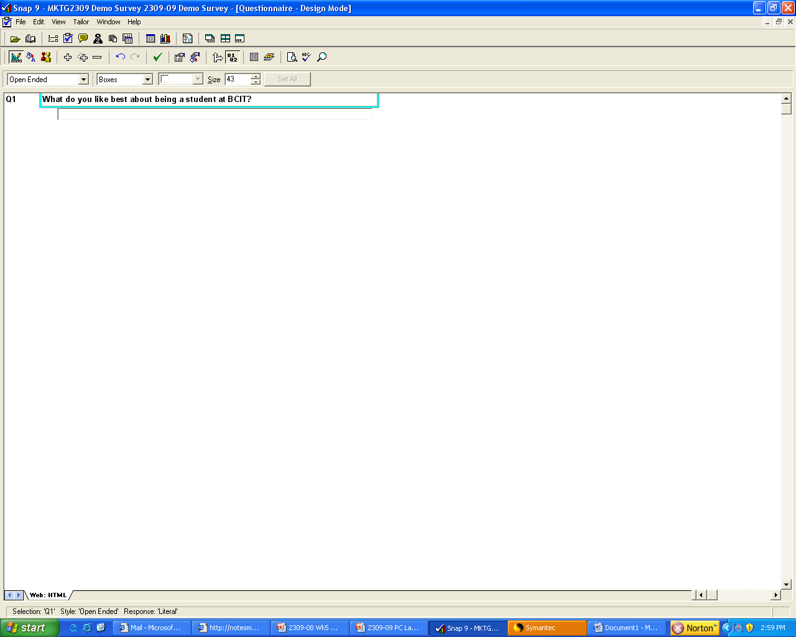
For example, I first created an ‘Open Ended’ Question.
Then I chose ‘Boxes’ so that I could adjust the size of the response box.
When I chose ‘Boxes’, this option for adjusting the box size appeared.
MKTG2341 PCLab 5

Slide 22
Now it’s your turn.
Using the Quick Start Guide as a reference, start producing your own questionnaire that includes titles, sub-titles, instructions, as well as closed ended, open ended, ‘other-specify’, and grid questions.
Play around with the formatting options so that you get used to
MKTG2341 PCLab 5

